Slide 1

DSO 510: Project 3

Slide 2
Phase 1 & 2

Slide 3
Introduction
Goal Definition:
Business Goal: Investigating how salaries for data scientists are impacted by a variety of factors including company size, % remote, and job title. This analysis is meant to inform data scientists on the best strategies to maximizing their salaries.
Variables:
Dependant Variable: Salary
Independent Variables: Experience level, Employment Type, Job Title, Remote Ratio, Company Size, Year, Unemployment Rate, Employment Rate
Categorical Variables: Year, Employment Type, Employment Level, Job Title, Company Size
Numerical Variables: Salary, Remote Ratio, Employment Rate, Unemployment Rate
Calculated Variables: Employment Rate, Unemployment Rate

Slide 4
Data Collection
Data Set 1: https://ai-jobs.net/ (We used the Web Scraping extension to scrap and collect this data.)
Data Set 2: https://www.bls.gov/cps/cpsaat01.htm (We joined data set 1 and 2 using inner join.)
Observations: 289 rows for inner joined data set
Data Set 1: 606 rows
Data Set 2: 73 rows
We didn’t have any missing data.

Slide 5
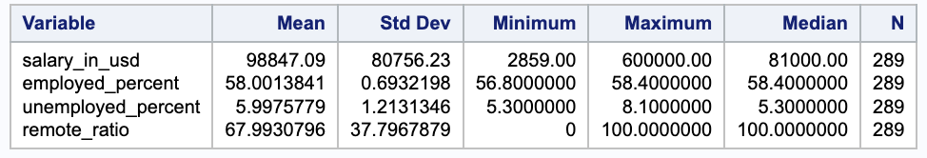
Descriptive Statistics
Salary has a high standard deviation, indicating that the salary data is spread out. The average salary is $98,847, but people get a wide range of salaries in data science jobs.
The medium of remote ratio is 100, which means that more than half of people in data science jobs worked remotely in 2020 and 2021.
After the COVID-19 pandemic, the employment rate is around 58% and the unemployment rate is around 6% in the US.

Slide 6
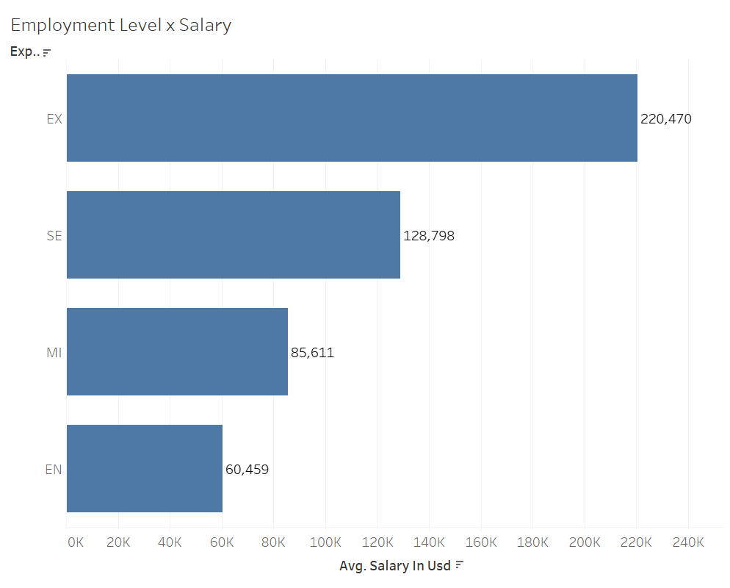
Experience Level x Salary
Experience Level and salary are directly related. The higher level the employers are at, the more salary they are paid.
Executive Level (EX) has the highest salary ($220,470), and Senior Level has the second most ($128,798)
Notes:
EN Entry-level / MI Mid-level / SE Senior-level / EX Executive-level

Slide 7
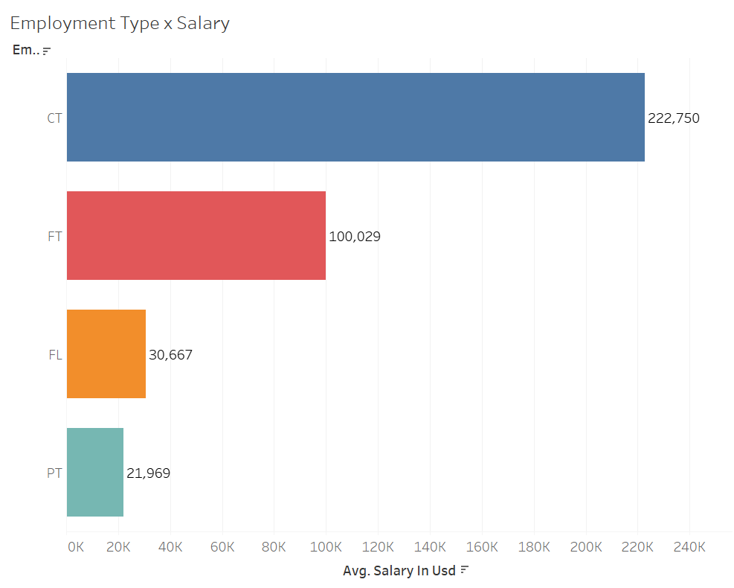
Employment Type x Salary
Contract workers have the highest salary ($222,750), and this category has twice more than the second highest group, the full-time workers ($100,029)
Notes:
PT Part-time / FT Full-time / CT Contract / FL Freelance

Slide 8
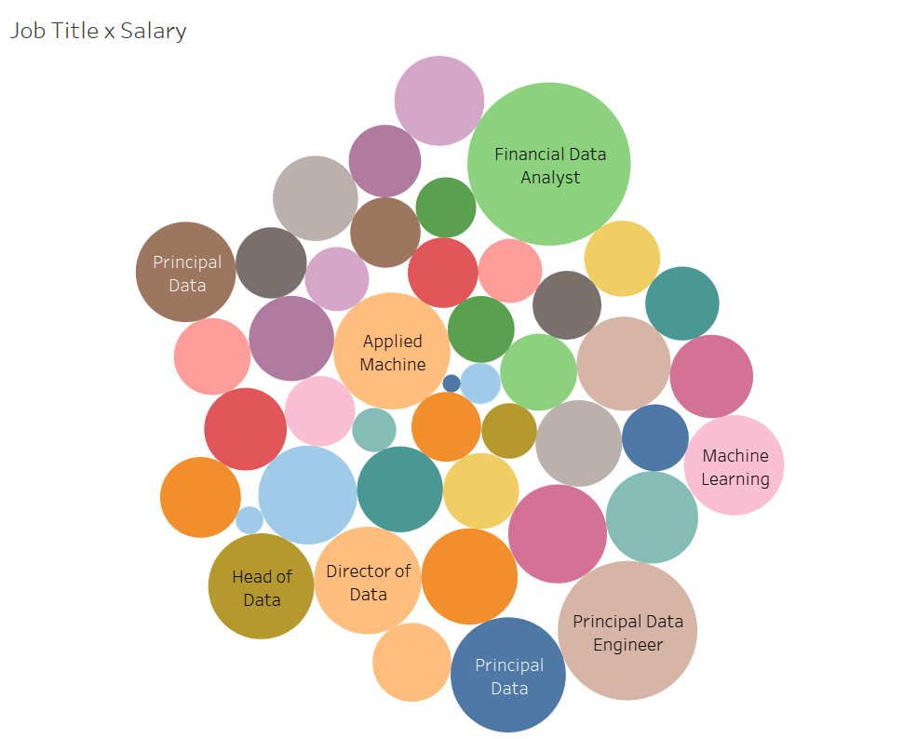
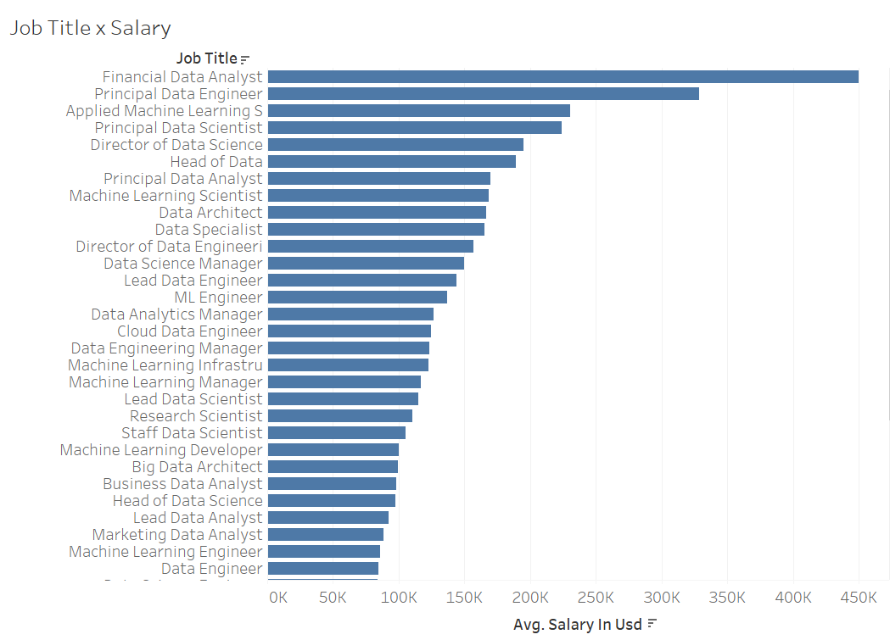
Job Title x Salary
On average, Financial Data Analyst has the highest salary ($450,000), Principal Data Engineer has the second ($328,333), and Applied Machine Learning S has the third highest ($230,700).

Slide 9
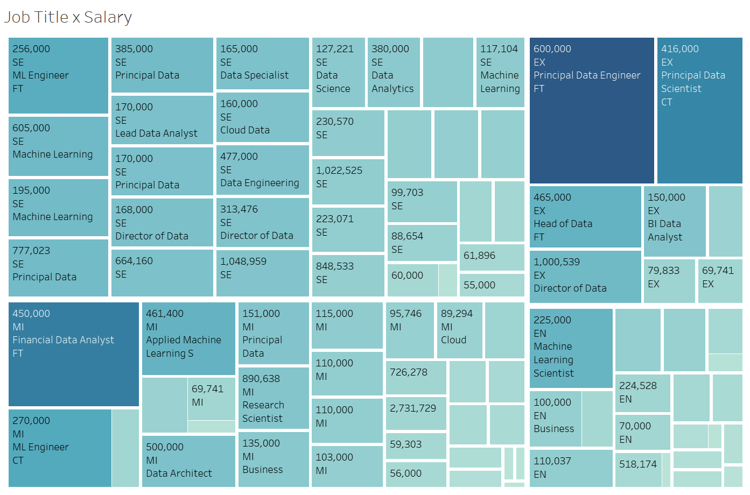
Job Title x Employment Type x Employment Level x Salary
A Financial Data Analyst position is much more lucrative than other positions, as depicted by the mid-level salary that is much higher than other executive positions

Slide 10
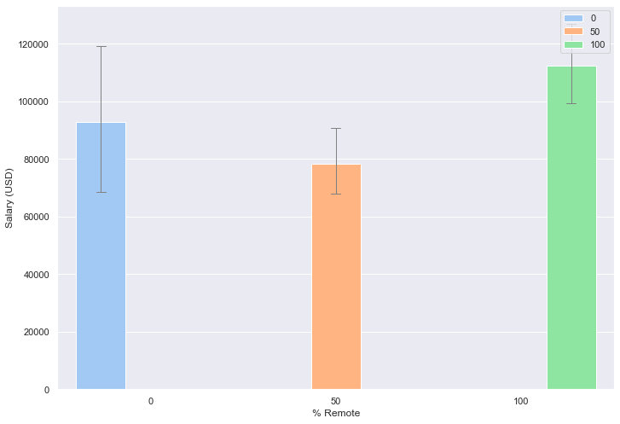
% Remote x Salary
A bar charted created using seaborn and pandas (Python)
This graph depicts that data scientists who work fully remotely have a higher salary than those who work in offices.

Slide 11
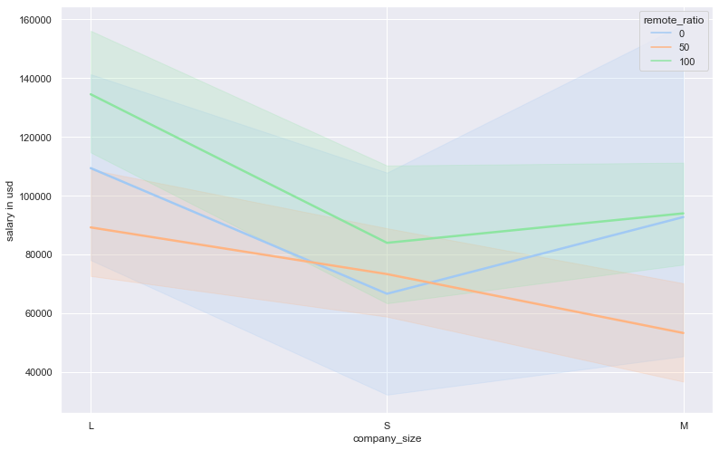
Company Size x Salary
This line chart depicts how salary differs depending on company size, with different colors depicting the remote ratios. Larger companies had the highest salaries, and were also more likely to have employees working 100% remotely.
Smaller companies had the lowest salaries with lowest remote ratio.

Slide 12
Key Findings
Contractors had the highest mean salary amongst all employment types. However based on research, contractor salaries don’t include the benefits that full time employees are entitled to, which often boost their salary significantly. This dataset didn’t include benefits or bonuses that data scientists would usually receive.
Data scientists who work fully in the office had a higher salary than those who worked remotely
Larger companies had the highest salaries, and were also more likely to have employees working 100% remotely. This is most likely because they have more resources and infrastructures in place to support remote work, while smaller companies don’t have the same flexibility.
Since financial data analyst gets a significantly higher average salary than other job titles, it indicates that the finance sector invests more in data science than other industries.

Slide 13
Recommendations
Seek out and negotiate hybrid and remote jobs to leverage higher salaries, as it is currently a common practice amongst the industry.
If remote work is preferred, seek out larger companies as they are more likely to accommodate this.
Seek out contract positions for an immediate salary boost. However, it is important to acknowledge that contract positions receive fewer to no benefits.
As the finance sector invests heavily in data scientist roles, it is recommended to find jobs in this industry for those seeking higher salaries.

